Slide 1
Club of Rome – EU Chapter
‘Agora’ meeting
4/2/2020
Location and catering kindly offered by ELIA

Slide 2
Welcome statement
by
Ilse Tant,
Chief Community Relations Officer
ELIA

Slide 3
Key words
Knowledge (data, facts, science-based,..)
Togetherness (connected, synergies, co-construction,…)
Trust (respect, delegate, share,…)

Slide 4
Club of Rome VISION
• « Emerge from emergency »
• Accelerate a better future for all
• Move towards more equitable economic, finance, socio-political models
• Ensure an inclusive human dimension to all systems change and transitioning
Notes:
1st one is key to discuss. Sense of Urgency but recognition that this feeling of emergency does not help in designing the necessary complex solutions.

Slide 5
Club of Rome MISSION
Holistic, long-term thinking for a better future for human kind and the planet , by
Enhancing intergenerational thought leadership and dialogue
Promoting thought leadership from new young leaders
Providing the space for difficult conversations and conflict resolution
Promoting greater gender, ethnic, geographic and age diversity
Continuing to promote a culture of deep thinking related to core global tipping points whilst offering spaces for co-creation of solutions and hope
Touch the minds and hearts of leaders and citizens across the globe through education, knowledge exchange and publications
Partnering between our members, associations and with enlightened leaders from the business, policy and NGO’s to ensure more impact
Priority on 5 HUBS !

Slide 7
CoR – EU Chapter MISSION
The Club of Rome EU-Chapter (CoR-EU) aims to impact European decision-making
1. analyse the root causes of the most pressing socio-environmental challenges from a scientific approach that incorporates a global, holistic, and long-term perspective
2. advocate for the most promising policies that achieve the above-stated goal at the European Union level, engaging key decision-makers in the public and private sectors as well as in civil society
3. connect the Club of Rome and its National Chapters with institutions of the European Union and mobilise their as well as its own members
4. convene actors from all sectors of society in a multi-stakeholder forum to identify catalytic political, social, and technological pathways towards alternative futures

Slide 8

How to Vote in the Agora?
Open your internet browser on on your phone/tablet/laptop
Go to this link: http://etc.ch/AaRx or scan this QR code

Slide 9
Agora meeting of the CoR-EU
, Jean-Philippe Cornelis Patrick Corsi, Jacques de Gerlache, Anne Goldberg, Alain Peeters
February 4 2020

Slide 10
Context : the holistic perspective claimed by the CoR
“The cornerstone of thinking of the Club of Rome (CoR) is (…) recognizing the interdependence of today's global challenges,described as "holistic, systemic and relevant in the short, medium and long term” which takes into account the complexity of systemic and complex.
The Club therefore defines its mission as that of promoting understanding of the global challenges facing humanity and of proposing ways of evolution through scientific analysis in a plea for “systemic solutions for a systemic crisis”.
In this context, the objective of the International CoR Conference of 2019 was 1) to better understand the points of view of those present; 2) to identify opportunities and obstacles to increase the influence of organizations and 3)to discuss common approaches that can make organizations "bigger than the money of their parts".
The Planetary Emergency Plan of the CoR already contributed to establish the key principles of the transformative European Green Deal and still needs to be complemented by "laying the foundations for systemic changes in the short, medium and long term.
These foundations are necessary to genuinely emerge from the emergency in an economy and a society supported by human and planetary prosperity and well-being ”.

Slide 11
To be taken into account: the essence of human: a speaking and social animal
Speech & social links triggered a critical mass of cultural knowledge (nature, techniques, people,…) transferred by « education » to young generation;
  Like Mowgli, no child can be grown alone; the « I » is resulting from all the said « you »;
« Terre-Patrie » (E. Morin & A.B. Kern) should be an ideal & universal goal: one human condition, one ancient, one destiny;
There is a missing scale between « I » and « Terre-Patrie »: the human groups or societies (regions, nations, tribes, …)
  3-layered time evolution of these increasingly complex structures: economy (rapid), education (mid), family structure (long)).
  from different historical/geographical evolutions, sometimes 1000-years-old, to the Universal declaration of human rights (1948, humanity);
  The more complex, the worst the status of girls and women (reproductive function);
  Driver in history: literacy (primary school, then secondary then higher education), that disrupts family structures especially when girls are concerned (fecondity transition)

Slide 12
The story of the belief of (western) man in his power over nature and legitimate wealth grabbing
Today Sapiens becomes a telluric force destroying its cultural and natural home: resources scarcity, loneliness, technology pressure, social media, algorithmic governmentality, genetic edition, digital fracture, …;
  Based on the types of stories we are told today : globalisation, development, (economic) growth, innovation, …;
  Destroying social links and putting our states of rules at stake.
A still patriarcal world dominated by men for the men: #MeToo, « autonomous » weapons, authoritarian political regimes, etc…;
  Competition for wealth: no social stability without social justice;
  Men and women should fight stereotypes together;
  Girl’s needs: role models & deconstruct unconscient biais and their perverse indirect consequences: IT, defense applications, etc….;

Slide 13
To reach these objectives: five major ecosystem and human balances must be identified and restored
We have indeed to be better(re) balanced:
with nature: restoring the climate, biodiversity and our ecosystems;
with (y)ourself: the sublimation of the power of the self through culture;
with others: "restoring vital fraternal links“ as expressed by Frans Timmermans in his short essay “Fraternity”;
with (our) convictions or their absence: how to calm imaginary fundamentalism, whether cultural, religious or political;
with an "Oiko(eco-lo)nomy" meeting and respecting these four main founding principles.

Slide 14

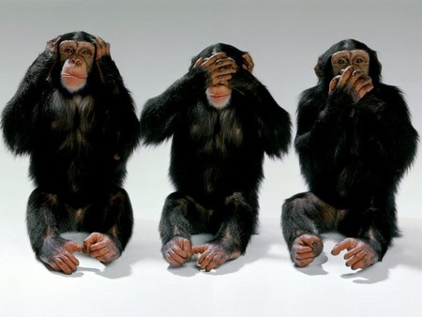
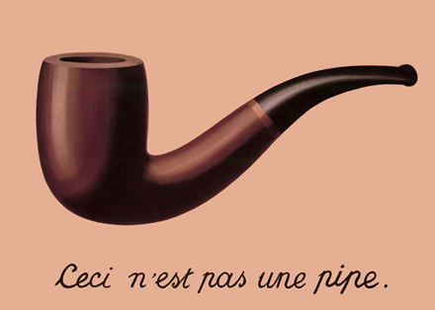
To this end …
… we have to « solve problems » in four main epistemiological categories:
  The science of nature or of the behaviour of the the living beings and the objects;
  The science of the individuals in the subjectivity and the psychology of their behaviours;
  The science of behaviour of the individuals between each other in their languages, culture, sociological and political rules;
  The science of transcendance in the understanding by communities of individuals of the laws of behaviour of objects through mythologic, religious or, more broadly, « philosophic » beliefs and construtions
This requires switches and changes in our minds and convictions as every civilization made her own balance of principles and solving techniques and strategies while often blind lovers of the build representations of reality to the point to deny these new evidences of this reality

Slide 15
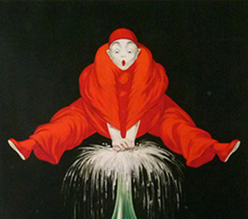
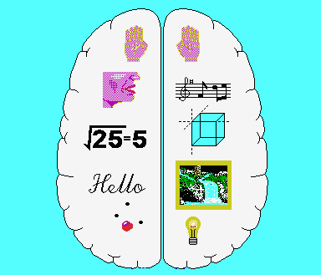
To reach the New civilisation requires “to boost the Noosphere in order to save the Biosphere”
For Heraclitus, Logos or “knowing the wisdom” is the principle of all things: It is a fundamental law supposed to raise human consciousness
The challenge then for him was “how causing an awakening to better perceive this Logos which escapes any man masked by stupidity".
This move impose to overcome the limits of existing paradigms :
Towards a more dynamic vision of the rules governing eco-lo-no complex systems escaping the restricted and too deterministic vision of Plato and neo-Cartesians
Towards the better integration of the systemic dimension, from education and trainings to methods and practices;
Towards also extended Ethics and Governance principles.

Slide 16
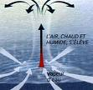
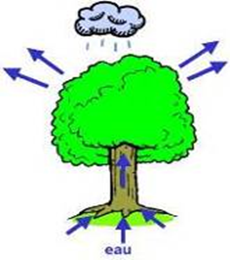

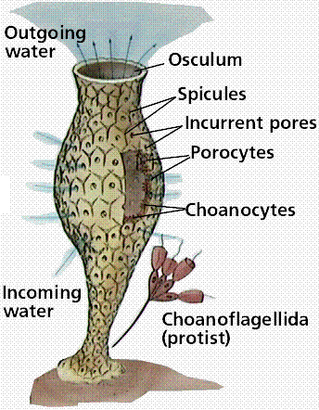
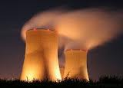
Towards the better integration of the dissipative “raison d’être “ of any complex system
"To those who descend into the same rivers always arise other and other waters. “
Heraclitus, had also already anticipated the (thermodynamic) principles now established that characterize the emergence of any “organized” system:
the maximalization of energy dissipation states resulting from local irreductible dynamic equilibria between ‘symbiotic forces“.
This from the simple cyclone to the most sophisticated ecological and socio-economic systems.

Slide 17
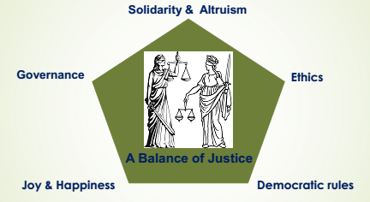
The importance of Ethics and Governance principles
One particular challenge for a New Civilisation is to integrate in the processes some principles of governance of a Balance of Justice (or of Ethics in contemporary terms )
Such rules applying common democratic rules would be landmarks of a “good civilization”, of solidarity and altruism, including towards Nature, building a kind of virtue of joy that can be endorsed and shared peacefully by citizens in their diversity.
Spinoza saw indeed Nature as a “whole” and Joy as the path to a superior figure of happiness by expressing a deep feeling of satisfaction and avoiding depression an sadness.

Slide 18
The EU-Chapter challenges for the coming years
To Develop five main hubs: New generation – Youth – Climate - E
To implement concrete initiatives and specific projects dealing with the priorities of the Planetary Emergency Plan, at the level of the national offices of the CoR, in particular that of the EU Chapter;
They should explicitly integrate their holistic dimension which takes into account the complexity of the systems that remains the cornerstone of the Club of Rome's thinking:
These initiatives must respond to the”crying need for increased inter-generational dialogue” and understanding in a society in which the younger generations are more and more aware of the immense future challenges, mobilized and engaged.

Slide 19
The NEW CIVILISATION Hub of the CoR-EU Chapter
Its specificity will be:
to attach all its importance to a truly strategic global vision that is interdisciplinary and mobilizes the young generations;
to stress the need for the systemic dimension in the methodologies applied; dimension also irreducible while many still do not seem able to embrace it, which inevitably causes many projects to fail;
To tackle more effectively in this context the most urgent challenges in each of the hubs, such as in particular the challenges of the Climate hub.
Its integrative methodologies should allow:
to be able to tackle without delay, and probably to test with its members a new formula of "co-construction" of projects which fully integrates complexity and the systemic approach
to identify how everyone can then act concretely to promote ‘individually and collectively the common agenda of the CoR and orient it particularly towards the EU.
the need to maintain their systemic perspective in each hub precisely through an adapted methodological approach.

Slide 20
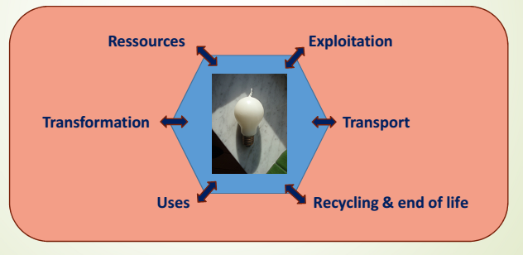
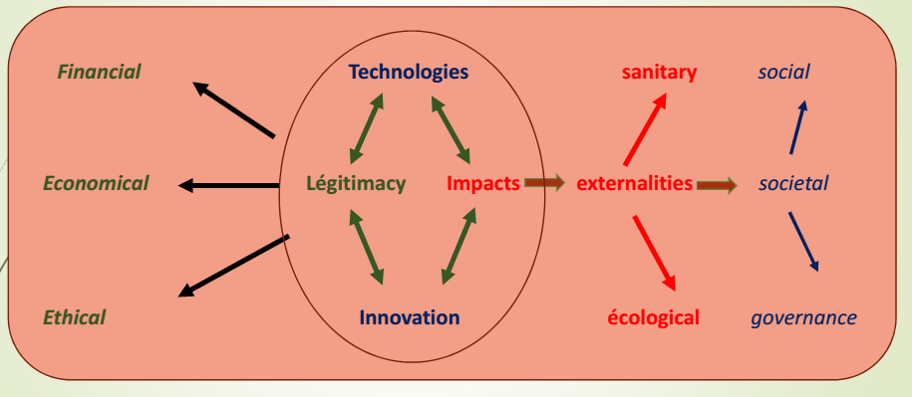
Implementation of the objectives of the EU-Chapter in the Hubs
Concrete projects will have to be analysed and/or build within the various Hubs y and aligned with the integrative approach.
The Climate hub: an example of the need of an integrative approach:
Integrating all its dimensions in the management of energy transitions

Slide 21
A systemic integration of a resilient management of a convivial econo-lo-gical system in all its dimensions
Cultural & Ethical
dimensions
Ecological
Economical
Knowledge
Creativity
Energy & Resources
Tools & Know-how
Costs & Impacts
Policies, demographics
Ecologicals
Expectations
Products & Services
Jobs & Values
Well-being
Sustainability &
Resilience
Ethics
DIMENSIONS
Financial
Societal
Means & Constraints

Slide 22
A methological strategy to develop such approach in the the CoR hubs
Designing innovative concepts
through
Exploring unknown spaces
Why
Witnessing
anomalies
Giving
solutions
PROBLEM
SOLVING

Slide 23
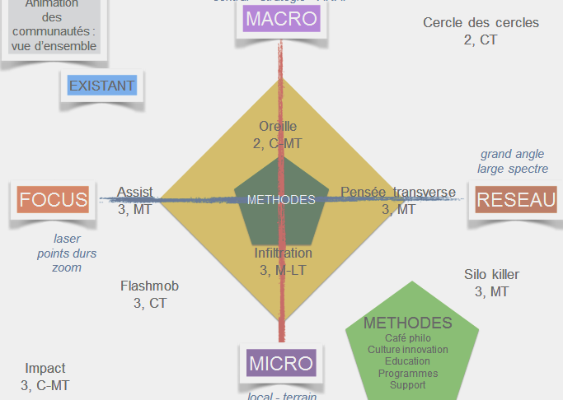




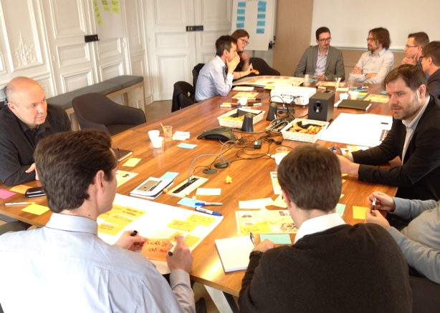

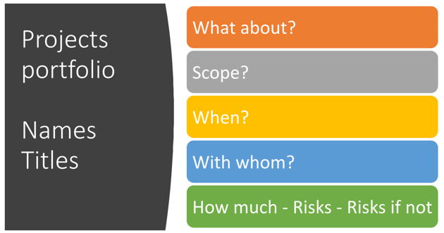
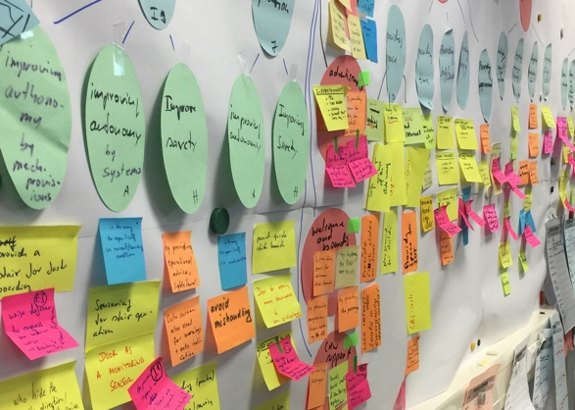

@
Stakeholders
How
Big Picture
Roadmap
UNKNOWNS
Describe Projects
DESIRABLE
PROBLEMATIQUE
Mutualize Knowledge
Generate «Realities»

Slide 24

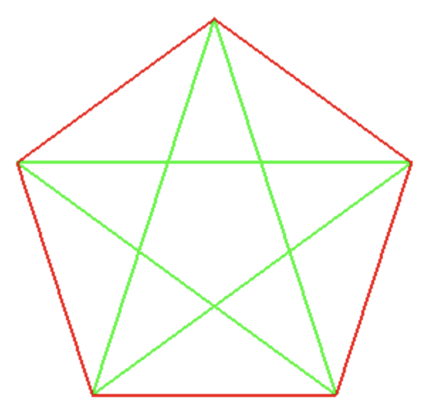


« An implementable
net zero climate impact balance sheet.
What
Climate
Finance
Economy
UNKNOWNS
DESIRABLE
Civilization
Youth
A neighbor-oriented society
that integrates competencies
and other resources
for widest shared benefit.
Youth engagement
as a forward ambassador
of human civilization.

Slide 25
The YOUTH hub
The new generations are committed to the immense present and future challenges of our societies and more and more mobilized to campaign for the same system changes as the members of the Club of Rome;
This trend should thus be translated among the key priorities of the EU-Chapter as actions to attract the new generations: innovative companies and start-ups, academics, administrations, students and civil society, NGOs, …;
  The 2019 CoR Summit tried indeed to respond to” the crying need for dialogue and better intergenerational understanding” and the young generation has to be considereda full and essential stakeholder in the future of CoR;
The CoR positioning will have thus to be more particularly explained to the younger generations who will be more sensitive to it because they are not yet locked into these paradigms that are essentially reductive and too exclusively dissociative.
  In particular the need for operational educational training initiatives in proven methodologies of systemic practice, a complementary dimension essential to the analytical and dissociative management of complex systems; without erecting the CoR as a “lesson giver” in the pejorative sense of the term.

Slide 26
The observation of a reversal of values between younger and older (at least in EU and western countries)
Rich (old) people preserve « business as usual » based on financial short-termism
Rich regions practice an « egoism of richest », challenging nations integrity (ES, IT, BE,..);
Demography and democracy: elections are locked by oldest;
(Poor) young people (often girls) call for immediate action to preserve long term existence:
  struggle to integrate society (unemployment, student debt);
  test old ways of social links: solidarity( inclusive) or inward-looking attitudes (exclusive society)
Failure of social lift: education as other public good, is at stake under un-regulated capitalism’s steamroller and competition paradigm (ex. : what type of political mandate did OECD receive to influence public policies in that realm)

Slide 27
Now, how to make it happen ??
The floor is yours, now !

Slide 28
COMMUNICATION FROM THE COMMISSION TO THE EUROPEAN PARLIAMENT, THE EUROPEAN COUNCIL, THE COUNCIL, THE EUROPEAN ECONOMIC AND SOCIAL COMMITTEE AND THE COMMITTEE OF THE REGIONS
The European Green Deal
(11.12.2019)

Slide 29
Ursula Von der Leyen Press Statement 11/12/2019 (Verbatim)
Very special day: the College of Commissioners agreed on the EU Green Deal
It is, on one hand, our vision for a climate-neutral continent by 2050 and, on the other hand a very dedicated roadmap to this goal, with 50 actions for 2050.
Our goal is to reconcile the economy with our planet, to reconcile the way we produce and consume with our planet and to make it work for our people.
It is, on one hand, about cutting emissions but on the other hand about creating jobs and boosting innovation.
I am convinced that the old growth model (based on fossil fuels and pollution) is out of date and out of touch with our planet.
The EU Green Deal is our new growth strategy, a strategy for growth that gives more back that it takes away.
We want really to make things different and to be the front runners in climate-friendly industries, in clean technologies, in green financing.

Slide 30
Ursula Von der Leyen Press Statement 11/12/2019 (2)
But we also have to be sure that no one is left behind. This transition will either be working for all and be just or not work at all.
Therefore the crucial part of the ‘just transition mechanism’:
We have the ambition to mobilize 100 billion euros precisely targeted to the most vulnerable regions and sectors
The EGD is a broad road map: we care also about biodiversity, forests, agriculture, food, green cities, circular economy.
We do not have all the answers yet. Today is the start of a journey but this is Europe’s ’man on the moon’ moment.
The EGD is very ambitious but it will also be very careful in assessing the impact and every single step we are taking.
The EDG is an invitation for all to participate. European citizens are changing their lifestyle to protect the climate and the planet.
Therefore, our EGD tells them that Europe is at their side.
We owe the EGD to our children because we do not own this planet. We just do have for a certain time a responsibility and now is time to act.

Slide 31
What the EU Green Deal is, what it is not? (source : WWF)
“A new growth strategy for Europe”
A clear vision towards 2050
An initial roadmap of key policies and measures needed to achieve the Green Deal
Will be updated as needs evolve
Integral part of the Commission’s strategy to implement the 2030 Agenda and SDGs
“Europe’s ‘man on the moon’ moment”
A real turning point for nature & climate??

Slide 32
1. INTRODUCTION - TURNING AN URGENT CHALLENGE INTO A UNIQUE OPPORTUNITY
This Communication sets out a European Green Deal for the European Union (EU) and its citizens.
It resets the Commission’s commitment to tackling climate and environmental-related challenges that is this generation’s defining task.
The atmosphere is warming and the climate is changing with each passing year. One million of the eight million species on the planet are at risk of being lost. Forests and oceans are being polluted and destroyed,……

Slide 33
2. TRANSFORMING THE EU’S ECONOMY FOR A SUSTAINABLE FUTURE
2.1. Designing a set of deeply transformative policies
To deliver the European Green Deal, there is a need to rethink policies for clean energy supply across the economy, industry, production and consumption, large-scale infrastructure, transport, food and agriculture, construction, taxation and social benefits.

Slide 34
1. TURNING AN URGENT CHALLENGE
INTO A UNIQUE OPPORTUNITY
2.2.3.
2.1. Designing a set of deeply transformative policies
2.
2.1.1.
2.1.8.
2.1.2.
2.1.7.
2.1.3.
2.1.6.
2.1.4.
2.1.5.
2.2.2.
2.2.1.
2.2.5.
2.2.4.
Greening National Budgets
Activating education and training
A green oath: ‘do no harm’
’
3
2.2. Mainstreaming sustainability in all EU policies
4
A time to act - together

Slide 35
3. THE EU AS A GLOBAL LEADER
The global challenges of climate change and environmental degradation require a global response. The EU will continue to promote and implement ambitious environment, climate and energy policies across the world. It will develop a stronger ‘green deal diplomacy’ focused on convincing and supporting others to take on their share of promoting more sustainable development. By setting a credible example, and following-up with diplomacy, trade policy, development support and other external policies, the EU can be an effective advocate. The Commission and the High Representative will work closely with Member States to mobilise all diplomatic channels both bilateral and multilateral – including the United Nations, the G7, G20, the World Trade Organization and other relevant international fora.

Slide 36
4. TIME TO ACT - TOGETHER: A EUROPEAN CLIMATE PACT
The involvement and commitment of the public and of all stakeholders is crucial to the success of the European Green Deal. Recent political events show that game-changing policies only work if citizens are fully involved in designing them. People are concerned about jobs, heating their homes and making ends meet, and EU institutions should engage with them if the Green Deal is to succeed and deliver lasting change. Citizens are and should remain a driving force of the transition.

Slide 37
Final paragraphs
The European Green Deal launches a new growth strategy for the EU. It supports the transition of the EU to a fair and prosperous society that responds to the challenges posed by climate change and environmental degradation, improving the quality of life of current and future generations.
The Commission invites the European Parliament and the European Council to endorse the European Green Deal and to give their full weight to the measures it contains.

Slide 38
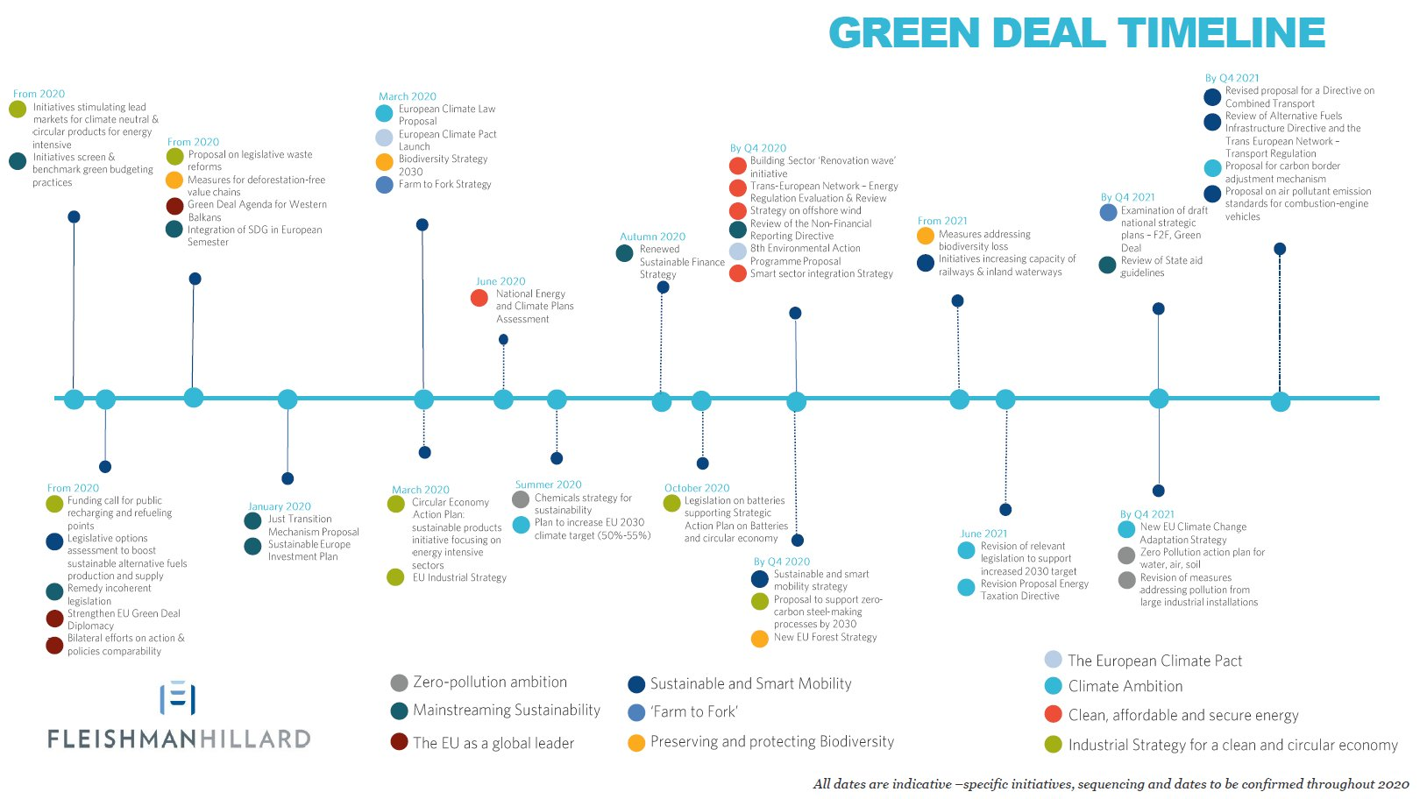

Slide 39
EU GD, the reaction from CoR on 11/12/20
The first guiding principle:
the transformative pathways for people - planet - prosperity go beyond a ‘Green Deal’ mantra and represent, in our view, the greatest opportunity for Europe’s economic and social well-being, climate and ecosystem resilience, as well as Europe’s political stability.
The second key guiding principle:
focus on innovative and proven solutions over the next ten years to ensure a rapid reduction of GHG emissions, biodiversity loss and social wellbeing.
The third essential guiding principle is the human dimension.
We need a robust ‘Just Transition’ framework that enables Member States and industries to shift out of high carbon and non-regenerative economic activities. This will create a more cohesive socio-economic fabric that embraces people-planet-prosperity and brings more citizens on the journey

Slide 40
I. Creating a Narrative that Unites Europe: A ‘New’ European Deal for People-Planet-Prosperity
Values what truly matters in society. New wellbeing indicators next to GDP.
Marries social security with ecosystems restoration to foster a holistic approach and enables a ‘just transition’ with equity, wellbeing and social cohesion at its core.
Catalyses a decade of action but explicitly lays the foundation for deep long-term economic, political and financial systems change away from short-term decision-making and profit-taking.
Prioritises ‘frugality’ and ‘sharing’, in both production and consumption, and promotes ‘cooperation’ over ’competition’.
The concepts of ‘work’ and 'jobs' need to be fundamentally rethought in face of an AI and robotics explosion.
Prioritises a research and innovation agenda that underpins a technological and governance revolution in service of people-planet-prosperity.
Ensures that the European Climate Pact becomes a Pact for Europeans

Slide 41
III. Emerging from Emergency: A New Transformative Pathway
Bundling economic indicators to move beyond GDP:
A ‘just transition’:
Digitalisation and Exponential Technology
Innovation and Education

