Slide 1
SUSTAINABLE EUROPE FROM 1992 TO 2024 Geneviève Pons Director of the Jacques Delors Institute Brussels office
© Institut Jacques Delors

Slide 2
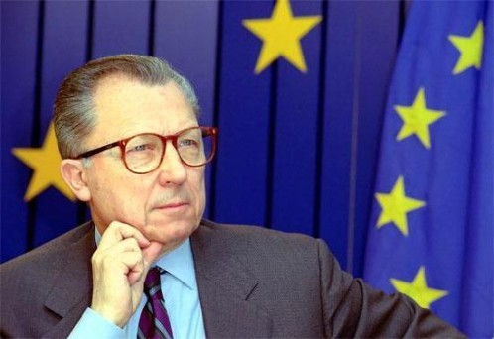
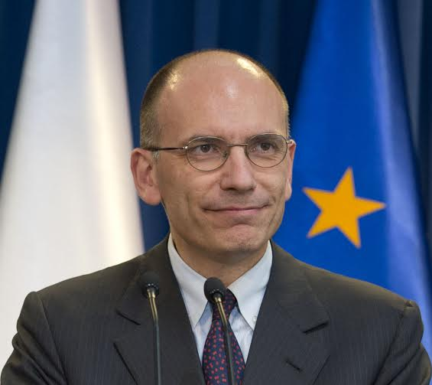
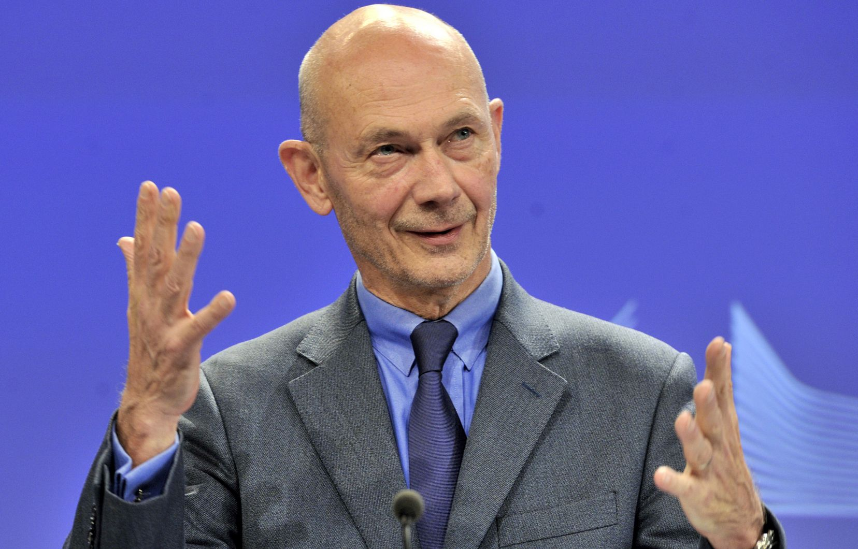
JACQUES DELORS INSTITUTE: WHO ARE WE ?
Jacques Delors
Enrico Letta
→ We are the European think tank founded by Jacques Delors in 1996 (under the name Notre Europe), at the end of his presidency of the European Commission. We are committed to a pedagogical and proposal-oriented approach to the European integration: "to build a bridge between citizens, media and decision-makers".
→ Our aim is to produce analyses and proposals targeting European decision-makers and a wider audience, and to contribute to the debate on the European Union.
→ The first office opened in Paris and finally had a twin-brother in Berlin in 2014. The Brussels office opened a year ago and is aimed at representing the Jacques Delors Institute and presenting its publications to the European Decision-makers.
Pascal Lamy
© Institut Jacques Delors

Slide 3
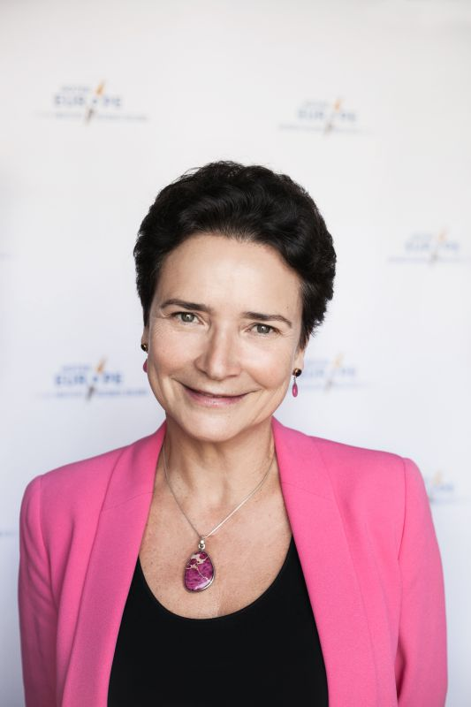
SPEAKER Geneviève Pons – Director of the Jacques Delors Institute Brussels Office
Geneviève Pons was in charge of environment and climate in the cabinet of Jacques Delors during his last two terms as President of the Commission (1991-1995).
She then held several management positions in the Commission services, and is now Honorary Director of the European Commission.
She was appointed Director of the Legal Department of the International Labor Office in 2013 and Director of the European Office of WWF in 2015.
Since November 2017, she is Director of the Jacques Delors Institute Brussels office.
She is a graduate of Sciences Po Paris, Sorbonne and ENA.
© Institut Jacques Delors

Slide 4
Sustainable Europe? A story in three episodes
1992-1995: Preparing and delivering Rio
2015-2017: Disappointed hopes
2019-2024: has time come for the big transformation?

Slide 5
1992-1995 Preparing and delivering Rio.
CO2 Taxation proposal
Rio speech on sustainable development
1994 White Book on growth competitiveness and employment

Slide 6
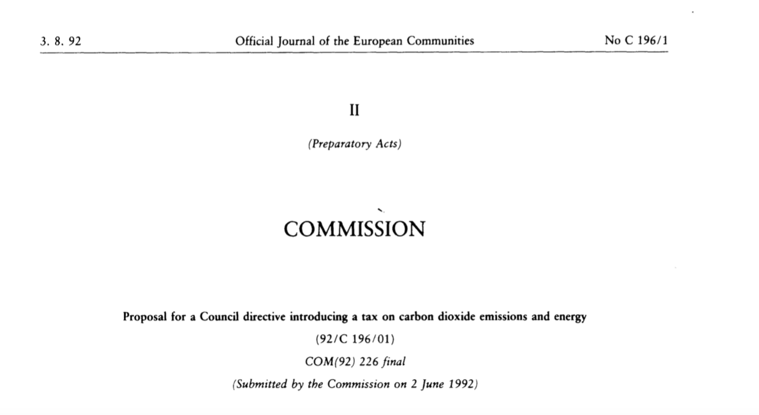
© Institut Jacques Delors

Slide 7
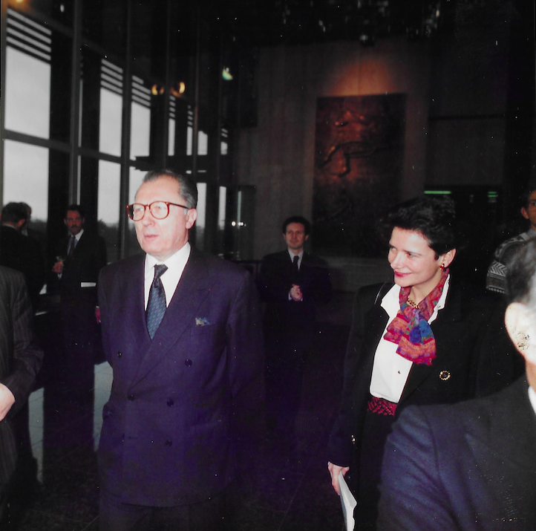
Jacques Delors and Geneviève Pons
in 1992
© Institut Jacques Delors

Slide 8
DISCOURS DE JACQUES DELORS A RIO 13 JUIN 1992
"LE CONCEPT DE DEVELOPPEMENT DURABLE NOUS INVITE A REAPPRENDRE LA VALEUR DES BIENS COLLECTIFS, DES RESSOURCES COMMUNES, A RETROUVER LE SOUCI DU LONG TERME. IL NOUS CONDUIT A INVENTER UNE NOUVELLE ETHIQUE DE L'ENVIRONNEMENT.
(...) C'EST LA CROISSANCE QUI NOUS DONNERA LES MOYENS DE NOS AMBITIONS, MAIS UNE CROISSANCE QUI DONNE UN PRIX A LA NATURE."
© Institut Jacques Delors

Slide 9
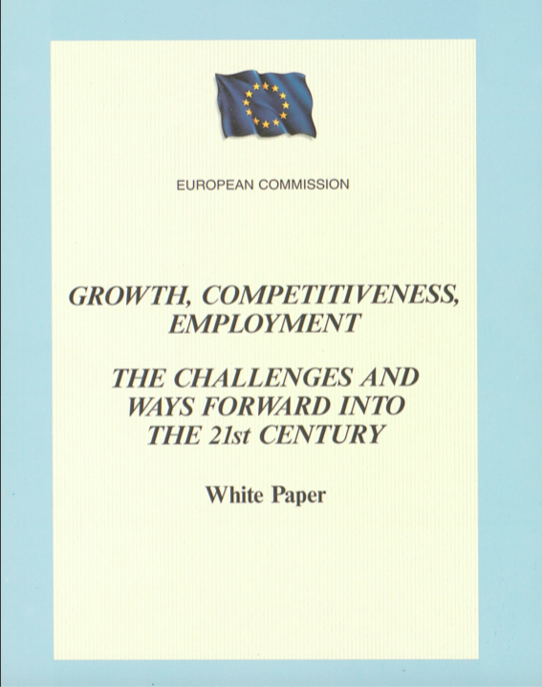
© Institut Jacques Delors

Slide 10
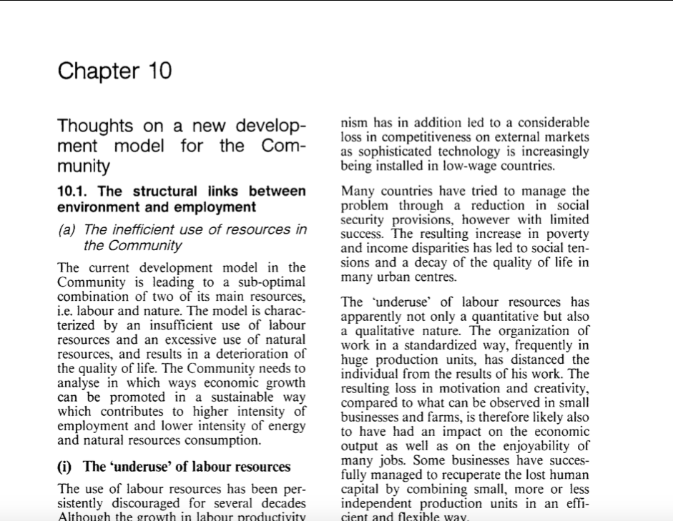
© Institut Jacques Delors

Slide 11
2015-2017: disappointed hopes
September 2015: New-York
December 2015: Paris
23 June 2016: Brexit
8 November 2016: Trump

Slide 14
23 JUNE 2016 : BREXIT ! 8 NOVEMBRE 2016 : TRUMP !

Slide 15
DISCOURS DE JACQUES DELORS A RIO 13 JUIN 1992
© Institut Jacques Delors

Slide 16
DISCOURS DE JACQUES DELORS A RIO 13 JUIN 1992
"LE CONCEPT DE DEVELOPPEMENT DURABLE NOUS INVITE A REAPPRENDRE LA VALEUR DES BIENS COLLECTIFS, DES RESSOURCES COMMUNES, A RETROUVER LE SOUCI DU LONG TERME. IL NOUS CONDUIT A INVENTER UNE NOUVELLE ETHIQUE DE L'ENVIRONNEMENT.
(...) C 'EST LA CROISSANCE QUI NOUS DONNERA LES MOYENS DE NOS AMBITIONS, MAIS UNE CROISSANCE QUI DONNE UN PRIX A LA NATURE."
© Institut Jacques Delors

Slide 17
2019-2024: Towards sustainable Europe?
A sustainable coalition contract?
A successful energy and ecology transition?

Slide 18
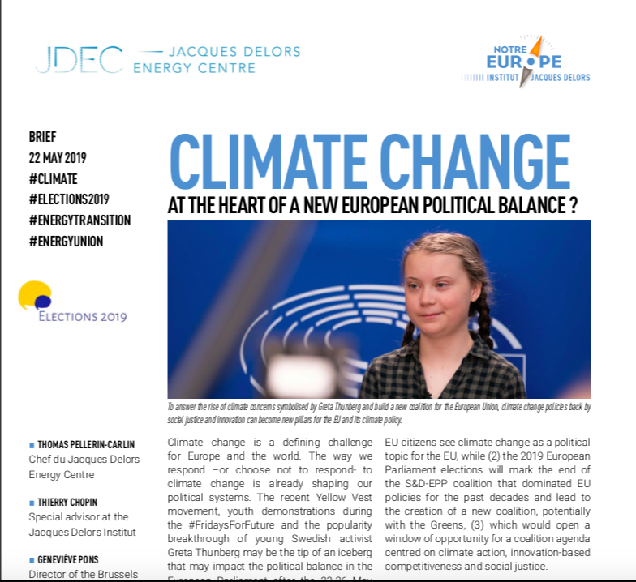
Jacques Delors Institute latest publications BRIEF (MAY 2019): Climate change at the heart of a new european political balance? Thomas Pellerin-Carlin, Geneviève Pons, Thierry Chopin

Slide 19
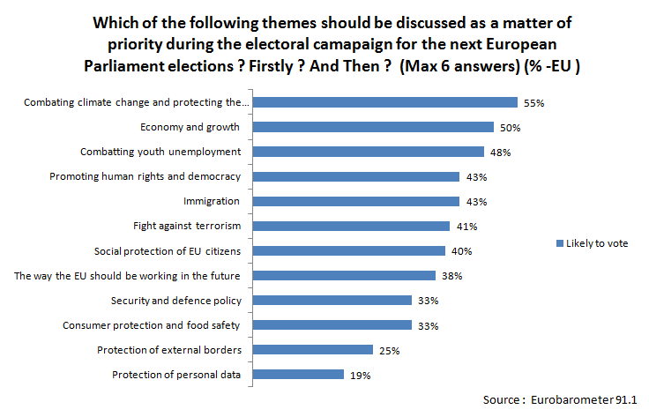
2019: Climate change and protecting the environment as top-priority of EU voters.

Slide 20
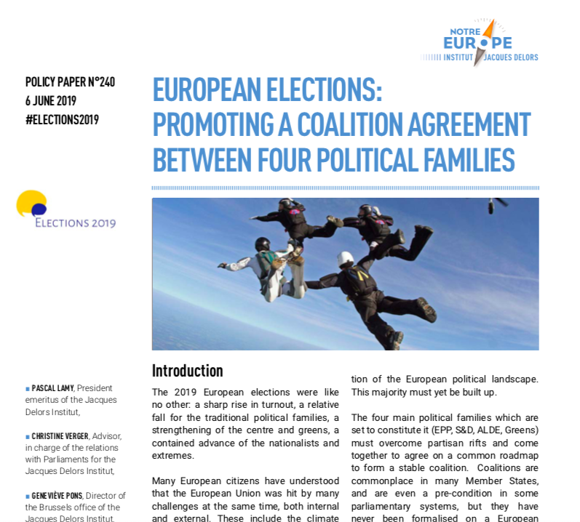
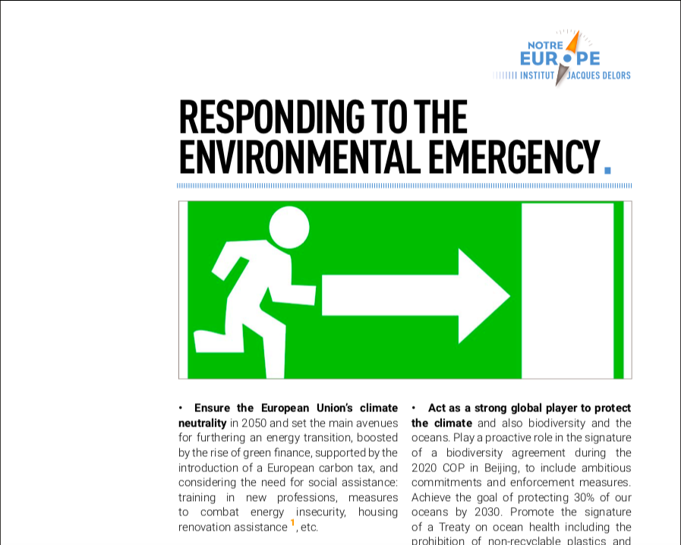
WHAT ABOUT SUSTAINABILITY IN THE FUTURE COALITION AGREEMENT? POLICY PAPER (JUNE 2019) "Promoting a coalition agreement between four political families", Pascal Lamy, Geneviève Pons, Christine Verger

Slide 21
21.06.2019 Draft compilation Chapeau text Colour code: Blue: S&D proposals Green: EPP proposals Yellow: COMP proposals Grey: new proposal Greens (Charter of Fundamental Rights) WG 1: Environment and biodiversity, sustainable mobility, fighting climate change and zero waste, food, health Introduction 1. Mitigating the dramatic consequences on ecosystems, the economy, human health and wellbeing of the climate and biodiversity crisis requires the EC to take more decisive and faster action to limit global warming in line with the Paris agreement and to halt and reverse the loss biodiversity in the EU and worldwide. 2. The ecological transition is therefore a necessity but also an opportunity for jobs creation and for delivering well-being for all. The social, economic and technological changes required must be just and mitigate the hardship for citizens and regions across the EU that would be most affected. A future-oriented industrial policy will allow the EU to face the challenges while upholding its economic competitiveness. 3. The implementation of the United Nations 2030 Sustainable Development Goals (SDG) will be an overarching priority for the EC as a whole, across all sectors. The EC will adopt an overarching EU SDG strategy guiding the actions of the EU and its Member States. (New legislative proposals shall be subject to an impact assessment that include an “SDG test”, putting the reduction of the ecological footprint and the reduction of inequalities on the same footing as the economic assessment)

Slide 22
CONCLUSION
A pathway towards sustainable development for all?

Slide 23
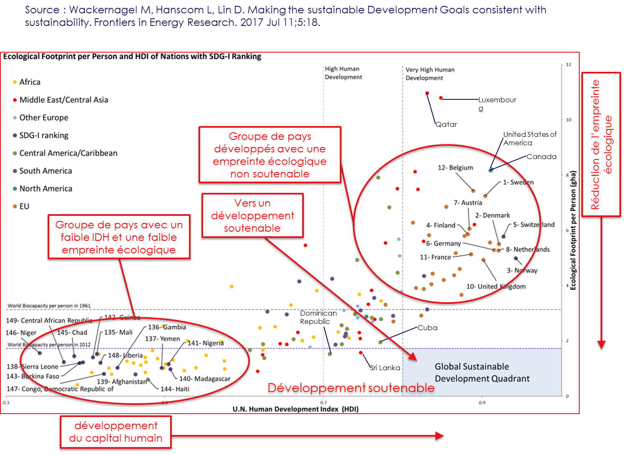
"Each and every country is currently living a transition to sustainable development"

