Slide 1
The Greening of Europe
A Journey through 50 years Environmental Action

Slide 2
THIS IS NOT A LECTURE
THIS IS NOT A SPEECH
THIS IS NOT AN AUTOBIOGRAPHY
but….

Slide 3
… an informal talk, an overview of milestones in my professional life,
a testimonial for all those believing that
Humans are part of Nature and should care for their Only One Earth.

Slide 5
Some conclusions
Our industrial society is not going to collapse: it is already collapsing.
Homo sapiens became master and owner of Nature. Western Man imposed/exported his greedy way of life all over the World.
Our civilisation has lost the sense of spiritual values.
Growing consciousness, but little effective change in human behaviour.
Leadership is lacking the courage to enforce a radical change of course.
Citizens behave mainly as consumers. Changing habits is difficult.

Slide 6
Some conclusions
We cannot foresee the unforeseeable, but we can try to shape the future.
Science and technology are only means, not the objective.
We should quit the growth obsession and our addiction to consumption. Seek a balance between efficiency and resilience.
A new civilisation is only possible through a new Enlightenment based on values systems with a spiritual dimension.

Slide 7
A FIRST GLOBAL ANALYSIS AFTER 50 YEARS
Environmental awakening in the Western world started
in the fifties and sixties.
In the last fifty years we distinguish in Europe three major phases:
the socialisation of the environmental movement;
the politization of the environmental movement;
the internalisation of the environmental concerns.

Slide 8
BACK TO HISTORY
The Environmental Movement in Europe
Rising Awareness in Industry
New Approaches in EU Policy making
Science and Media

Slide 9
The Environmental Movement in Europe
1970 European Year of Nature Conservation
1970 Bond Beter Leefmilieu / Inter-environnement
1972 Stockholm: The U.N. Conference on Human Environment
1973 Small is Beautiful
1974 The European Environmental Bureau
1976 Ecoropa: Ecological Europa
1976 Denis de Rougemont: « L’Avenir est notre Affaire. »
1979 European Parliament: The Greens are there!
1989 European Year of the Environment

Slide 10
1970 European Year of Nature Conservation
Council of Europe, Strasbourg “Now that the scale and seriousness are starting to be revealed, would we really dare keeping matters as they stand, leaving to tomorrow’s generation a completely artificial civilisation in a poisoned, hostile environment which would leave little room for human beings? If so, we would then abdicate our human dignity.”
H.R.H. Prince Albert of Belgium

Slide 11
1970 Bond Beter Leefmilieu/Inter-environnement
A pioneering Belgian initiative
“Quality of life is a dimension of civilisation. More than ever the finality of life is at stake. This is not a matter of simple adaptation to new material obstacles.”
“The battle for environmental protection is a major social demand within the broader frame of the quality of life.”
Excerpts from: “fondements éthiques de l’action d’Inter-environnement”
« ethische grondslagen van de bond beter leefmilieu »

Slide 14
1972 Stockholm:
The U.N. Conference on Human Environment
Boosting environmental governance. First concern about sustainability
Upon initiative of the United Nations world leaders, heads of governments, industrialist, labour unions, social and environmental NGO’s from most nations (including communist China) gathered two weeks in the Swedish capital, under the scrutiny of the press, radio and television.
Besides impressive official plenary sessions there were numerous subcommittees, bilateral meetings, alternative forums and public street protests.
The conference boosted the creation of environment departments in many a national government.
The gap between the rich South and poor North was obvious and denounced.

Slide 15
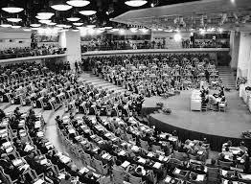

Slide 16
1973 “Small is Beautiful”
Economics as if people matters
Capitalism brings higher living standards at the cost of deteriorating culture and nature. Natural resources should be conserved.
Bigness leads to the depletion of the planet. Bigger is not better. Small is beautiful.
Good economy for people is a matter of appropriate scale of production and consumption.

Slide 17
1976 Ecoropa: Ecological Europa
Ecology needs Europe, Europe needs Ecology
Complex ecological interactions are not adequately addressed by addressing only one dimension of an environmental problem.
Democracy and public information and participation are key at local and national levels. They need to be complemented, however, by international cooperation, wherever impacts cross national borders.

Slide 18
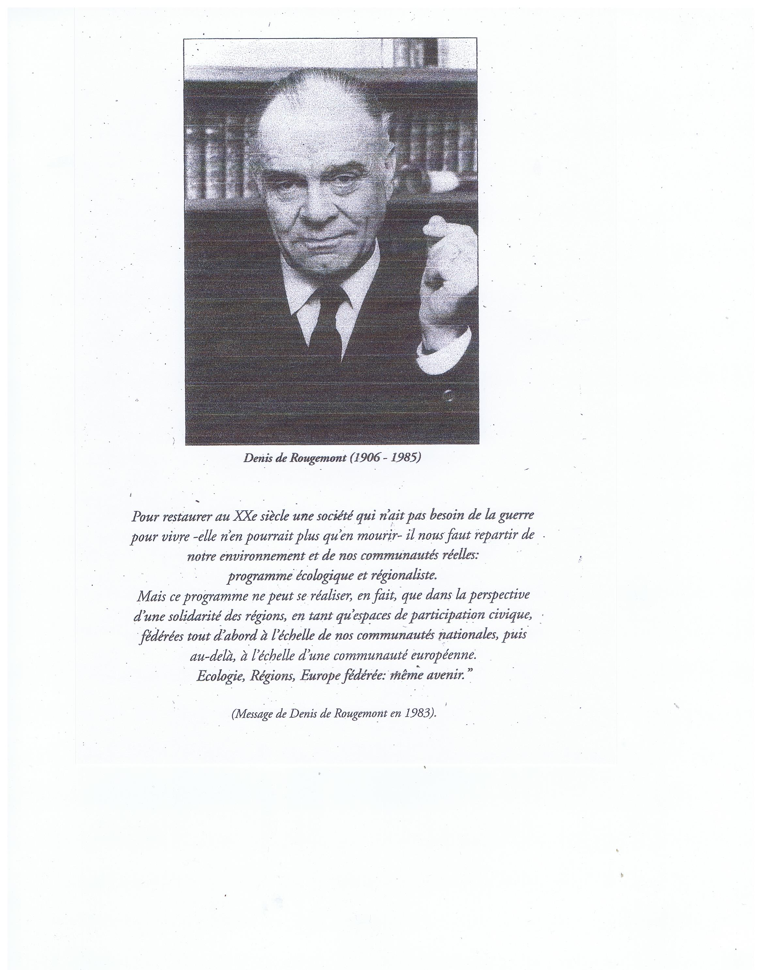

Slide 19
“L’Avenir est notre Affaire”
Our Future is the business of each individual citizen
Denis de Rougemont, a forgotten founding father of the unification of Europe after the world war II, developed his concept of a federal union built on the regions, rather than on the national states.
He stressed the importance of environmental protection and contributed to critical thinking on the industrial society.
“L’Avenir est notre Affaire” is a must for all. It calls for individual responsibility: the future is the business of all citizens. It requires a change in our individual behaviour and in public governance. Hence democracy requires “spaces for civic participation.

Slide 20
1979 European Parliament elections
Ecological Manifesto for a Different Europe
“The ideological spectres of the last few centuries still haunt Europe. Worse, these economaniac spectres have become a reality and living reality has become a spectre.
If we look at what has been achieved and what is to be expected if we continue along the present road, we see that our society has not become the safe, healthy and peaceful community we once expected. On the contrary, it is losing meaning, quality and satisfaction.
In important aspects the achievements of progress turn out to be as destructive as its failures. More and more citizens of Europe share a conviction that the present road will lead deeper into unemployment and inflation, energy dilemmas, the exhaustion of depletable resources of the environment, the spread of radioactivity and genetic deterioration, the disappearance of free space, quiet and serenity, the extinction of plants and animal life, a global arms race and a fierce conflict between North and South. All these symptoms are signals of a crisis of civilization...”

Slide 21
Alliance of the first political greens
Press conference in March 1979, Brussels
Some candidates:
Die Grünen (D): Petra Kelly, Roland Vogt, Herbert Gruhl
Europe Ecologie (F): Solange Fernex
Partito Radicale (I): Marco Panella
Agalev: Mark Dubrulle (B)
Ecology Party: Jonathan Tyler (GB)

Slide 23
European Green Pioneers
Some dear and inspiring friends
Manfred Siebker (D) Petra Kelly (D + IRL) Edouard Kressmann (F) Denis & Nanik de Rougemont (CH) Wouter & Sigrid van Dieren (NL) Brice Lalonde (F) Solange Fernex (F) Teddy Goldsmith (GB) Diana Schumacher (GB) Cherry Mares (GB) Stanley Johnson (GB) Ernst & Christine von Weizsäcker (D) Santiago Vilanova i Tané (E) Marco Panella (I) Willem Hoogendijk (NL) Orio Giarini (I) Wolgang Sachs (D) Sigmund Kvaloy (N) Roland Vogt (D) Paul & Freda Blau-Meissner (A) Alain Hervé (F) Jean-Marie Pelt (F) Pierre Laconte (B) Serge Moscovici (F) Armand Petitjean (F) Jacques Grinevald (CH) Bernard Charbonneau (F) Carl Amery (D)

Slide 24
Greenpeace, Friends of the Earth, WWF et alii
Greater visibility for international NGO’s
In the seventies and eighties many demonstrations and public protests on the streets, around polluting sites, energy facilities, against threatened natural sites, road construction, urban developments took place all over Europe.
Given the growing role of the EU institutions liaison and representation offices were opened in Brussels.
Large mobilising campaigns were conducted.
Greenpeace was definitely one of the most audacious militant organisations with spectacular actions, hitting the media headlines.

Slide 25
Rising Awareness among Industry
1976 IPRE / 1993 ESED
Major industrial corporations create the function of environmental coordinator to deal with the increasing public concern about pollution.
Practitioners establish an International Professional Association for Environmental Affairs becoming ESED: European Society for environment and Development as a platform for debate with scientists, public authorities and NGO’s.
AERPF.
Association Européenne pour la Réduction de la Pollution des Fibres
How in the eighties a major environmental problem (asbestos) led to a voluntary private initiative to address it, contributing to alert authorities and public opinion. Not limited to denouncing a very critical health situation, but disseminating unbiased information, proposing adequate measures and offering services.

Slide 26
Rising awareness in industry
Environmental Management
In the Western world environmental consultancies mushroomed in the eighties and nineties, often from a core of public affairs professionals, law offices, engineering bureaus, research institutes. Within universities sustainable development centres were created.
In Europe some were initiated by green fellows: the IEEP in Bonn, Brussels, London and Paris; the Wuppertal Institute in Wuppertal; Ecobilan in Paris; IMSA in Amsterdam, EMSA in Brussels.
I dealt with: Life Cycle Analysis, Waste management, Ecotaxes, Environmental conflict resolution, Priority waste streams, Plastic waste recycling, River water quality, Surveys and studies on societal issues

Slide 27
New approaches in EU policy making
From SEPC in 1973 to DG XI in 1984, and more since then…
In 1973 the European Commission created the Environment and Consumer Protection Service under the French Michel Carpentier as Director. A first step…
1987-1988 European Year of the Environment
Stimulated, supported and co-funded many projects in all EU Member States
The Life Programme
Starting with an inventory of national or local campaigns and modest co- funding Life developed very successful programmes in the EU Member States
Consensus building with all stakeholders
In the nineties DG Environment and facilitators introduced a new methodology for preparing regulations on prior waste streams through consensus building processes with all stakeholders. Each process lasted between 2 and 3 years, piloted by a Member State: France for End-of-Life Vehicles, the U.K. for Health Care Waste, Italy for Electric and Electronic Waste.

Slide 28
Science and Media
Indispensable actors contributing to environmental awareness
In the past 50 years all scientific disciplines, all R&D programmes, most teaching have increasingly taken the environmental parameter increasingly taken into account.
Many scientists built bridges with environmental and social NGO’s.
An interesting initiative in Belgium was the independent non-profit association GreenFacts, Scientific facts on Health and Environment.
The press at large has paid more attention to the negative news than to the positive.
Audio-visual media have often launched educational programmes on nature conservation and environmental protection, supporting also nation-wide campaigns.

Slide 29
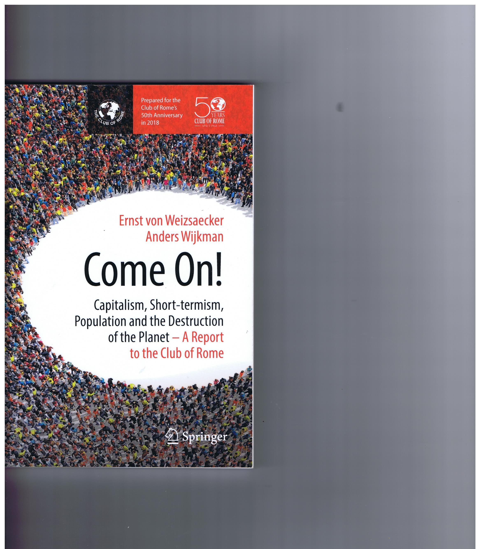
The Club of Rome EU-Chapter

Slide 30
There is a tide in the affairs of Men
which taken at flood
leads on to fortune.
William Shakespeare

